Slide 1
Product Sales and Customer Reporting
Muralidharan Singaravel

Slide 2
Brief Overview
The organization is a Communications and Media Company and one of the largest cable provider in the U.S. that provides high-speed Internet, digital TV, pay TV products and voice services plus advanced home security to approximately 4.9 million residential and business customers in 21 US states

Slide 3
Objective
Provide daily, weekly, and monthly sales and customers reports to the Sales Management team on the customers who are subscribed to cable, internet, home security or phone services provided by the organization.
Provide insights on the competitors available in customer region which will help the management in either providing offers/discounts to the existing customers who have a tendency to churn or cross sell other products which are offered thereby improving sales effectiveness

Slide 4
Direct Users
Data Analysts
retrieve, gather and analyze data about the customers and competitors in a region.
organize it and use it to build reports, charts and visual presentations on past customer patterns, new trends, subscription purchases, and regions to create models for predicting future customers or subscription purchases

Slide 5
Direct Users
Business Analysts
Help organization to make more effective business decisions and plans.
query the database as part of analysis to get information to help management with best plan to increase sales, customer use, subscription purchases etc.
using the data to identify problems and solutions. They will also create and execute SQL test scripts as part of the solution built by the developers.

Slide 6
Direct Users
Developers
work directly with business analysts and build scalable data visualizations in Tableau and/or MicroStrategy which connects to the SQL database, and perform ad-hoc analysis on business problems that provide actionable insights on the customers. They will also write complex SQL and Custom SQL queries to support the business requirements
The Indirect Users of the database system are Project Managers and Business Users
using the dashboards and presentation provided by the Data Analysts, Business Analysts and Developers to build business plans for the company

Slide 7
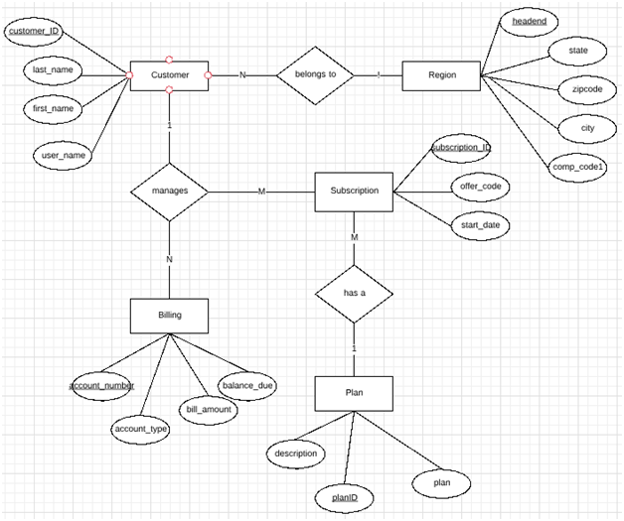
E-R Diagram

Slide 8
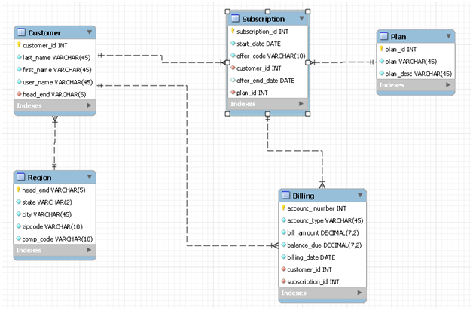
EE-R Diagram

Slide 9
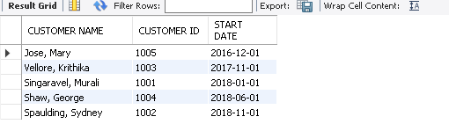
Query 1
Business Use case: Get the list of customers and the dates on which they first started their subscription.
Technical Use case: A query connecting two tables.
SELECT CONCAT(c.last_name, ', ',c.first_name) AS 'CUSTOMER NAME', c.customer_id AS 'CUSTOMER ID', MIN(s.start_date) AS 'START DATE'
FROM customer c
JOIN subscription s ON c.customer_id= s.customer_id
GROUP BY c.customer_id
ORDER BY s.start_date;

Slide 10
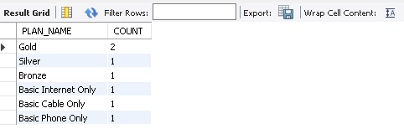
Query 2
Business Use case: Find what plans are subscribed by most users, and see which subscriptions may need to be advertised more,
Technical Use case: A query that addresses one of the descriptions in project one and connecting two tables.
SELECT p.plan AS 'PLAN_NAME', COUNT(s.plan_id) AS 'COUNT'
FROM subscription s JOIN plan p USING (plan_id) GROUP BY plan_id;

Slide 11

Query 3
Business Use case: Get the list of customers who are past their billing due date and have to be charged late penalty fees in the next billing invoice.
Technical Use case: A query that addresses one of the descriptions in project one and connecting two tables.
SELECT CONCAT(c.last_name, ', ',c.first_name) AS 'CUSTOMER NAME', c.customer_id AS 'CUSTOMER ID', b.balance_due AS 'BALANCE DUE', b.billing_date AS 'BILLING_DATE'
FROM customer c JOIN billing b USING (customer_id)
WHERE b.balance_due > 0.00 AND b.billing_date < current_date() ORDER BY c.last_name;

Slide 12
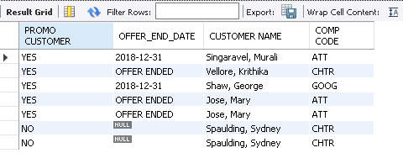
Query 4
Business Use case: Returns list of customers, competitors and whether the promotional offer has ended or not. Helps to identify customers who are likely to change their provider, with an assumption that a customer may churn at the end of the new customer signup offer.
Technical Use case: A query that contains two select statements and three tables.
SELECT 'YES' AS' PROMO CUSTOMER' , CASE WHEN s.offer_end_date < current_date() THEN 'OFFER ENDED' ELSE s.offer_end_date END AS'OFFER_END_DATE', CONCAT(c.last_name, ', ',c.first_name) AS 'CUSTOMER NAME', r.comp_code AS 'COMP CODE' FROM subscription s
JOIN customer c USING (customer_id)
JOIN region r USING (head_end) WHERE s.offer_end_date is NOT NULL
UNION ALL
SELECT 'NO' AS' PROMO CUSTOMER' ,
S.offer_end_date AS 'OFFER_END_DATE',
CONCAT(c.last_name, ', ',c.first_name) AS 'CUSTOMER NAME', r.comp_code AS 'COMP CODE' FROM subscription s
JOIN customer c USING (customer_id)
JOIN region r USING (head_end) WHERE s.offer_end_date is NULL;

Slide 13
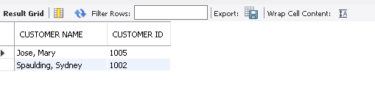
Query 5
Business Use case: Get the list of customers who have multiple subscriptions to see if a bundle plan can be advertised to these customers.
Technical Use case: A query that contains two select statements and two tables.
SELECT CONCAT(c.last_name, ', ',c.first_name) AS 'CUSTOMER NAME',
c.customer_id AS 'CUSTOMER ID'
FROM customer c
WHERE c.customer_id IN
(SELECT customer_id
FROM subscription
GROUP BY customer_id
HAVING COUNT(*) > 1)
ORDER BY c.last_name;

Slide 14
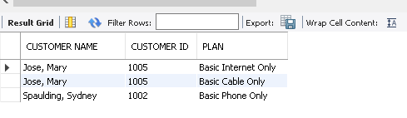
Query 6
Business Use case: Get the list of customers who are subscribed to just one product (Basic Internet Only or Basic Cable Only or Basic Phone Only) so that other products can be advertised for cross sell.
Technical Use case: A query connecting three tables.
SELECT CONCAT(c.last_name, ', ',c.first_name) AS 'CUSTOMER NAME', c.customer_id AS 'CUSTOMER ID', p.plan AS 'PLAN' FROM customer c JOIN subscription s USING (customer_id)
JOIN plan p using (plan_id)
WHERE s.plan_id in (501,601,701)
ORDER BY c.last_name;

Slide 15
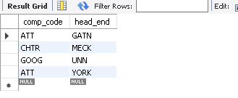
Query 7
Business Use case: Get the list of competitors in the customer region.
Technical Use case: A query that contains two select statements and two tables
SELECT r.comp_code, r.head_end
FROM region r
WHERE r.head_end IN
(SELECT DISTINCT(head_end)
FROM customer);

Slide 16
Implications
This database is targeted to improve the company’s daily operations and by studying the detailed reports, management can take action through well-calculated steps in order to improve the company’s efficiency and maximize the profits.
The current database is very limited in design, some of its limitations are:
There can be multiple competitors in the region which is not taken into account.
Household details like number of kids in the house, location, number of TVs are not captured which can provide valuable insights about the customer which influence the purchasing and viewing habits.
Set-top box and modem details can also be captured which can provide information about the customer viewing habits and help cross sell additional cable tv subscriptions.

Slide 17
Improvements
This database design can be improved by:
Adding a new entity which will capture all the competitors in the customer region along with the products and plans they offer.
Adding a Household table which will capture the customer HH composition, demographics, location, interests, home owners versus rental and no of devices.
Customer viewing details from the set-top boxes can also be captured in the database to track the television viewership across the footprint and the data can be used to analyze the network ratings, program viewership and advertising.

